Slide 1



May the Least Privilege Be With You: Exposing the Dark Side of Azure Service Principal Permissions
Marios Gyftos
Nikos Vourdas
2025
Notes:
Azure – Service Principle
Goal – showcase attack vectors and to help you rethink what is considered privileged in modern Azure environment

Slide 2
Disclaimer
The Opinions Expressed In This Presentation Are Our Own and Do NOT Represent Any Employer or Organization

Slide 3

$WHOAMI
Senior Offensive Security Consultant
GCPN, OSWE, OSCP, OASP
@GyftosMarios
CVE-2019-2432
CVE-2019-2431
CVE-2019-2430
CVE-2018-8607

Slide 4
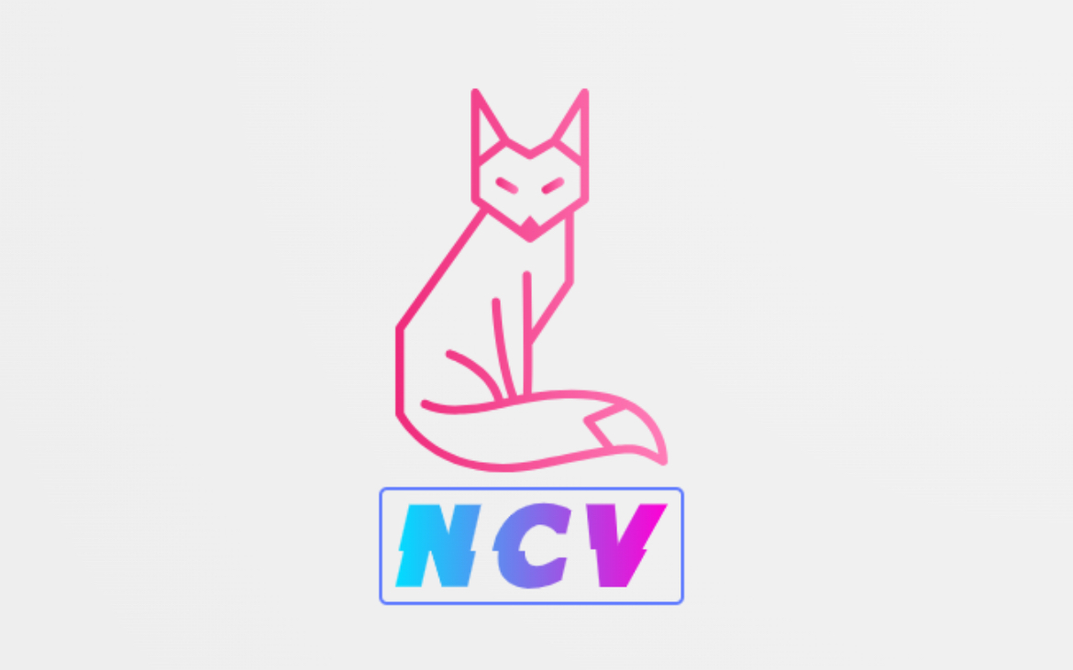
$WHOAMI
Senior Offensive Security Consultant
OSCE3, OSCP, OSWP, CRTL, CRTO, OASP
iCAST/TIBER-EU TLPT Experienced
CFP MEMBER @TheOffensiveX
@nickvourd
19

Slide 5

Table of Contents
Existing Landscape
To Olympus and Beyond the Clouds
FROM APP Owner TO AZURE FULL ACCESS
Leveraging SERVICE PRINCIPAL TO Access o365 mailbox
CODE EXECUTION via INTUNE LOB APPs
Abusing Azure DevOps Admin to compromise Privileged Service Principal
Community Toys for Girlz && Boyz
Detections & Remediation
Q&A
References
Notes:
outline current security landscape
— where most defenders are looking.
real-world scenarios
Showcase a tools to detect excessive privileges

Slide 6


Existing Landscape

Slide 7
Existing Landscape
Organizations focus on user monitoring and protection mechanisms:
Conditional Access Policies
Trusted devices
Multi-factor Authentication
Risky Sign-Ins
But User’s are not the only objects with Privileges in Azure
Notes:
User focused
Disconnect – attackers shift focus

Slide 8

Existing Landscape
Welcome to the World of Enterprise Applications
Enterprise Applications in Microsoft Entra ID enable secure access, automation, and vendor integrations with SSO, user assignments, and access control.
Enterprise Application ←→ Service Principal
Notes:
Why? – no conditional access or password rotation
automation, scalability, seamless integration High privileges

Slide 9
Existing Landscape
The Dominance of Enterprise Applications:
Their rise is inevitable — they drive innovation
Offer Powerful automation
Enable scalable identity integrations
Drive vendor adoption
Organizations increasingly trust them by default
Notes:
But Why? – automation, backups, devops, orchestration and deployment, device and user management

Slide 10

Existing Landscape
The Dominance of Enterprise Applications:
Their rise is inevitable — they drive innovation
Offer Powerful automation
Enable scalable identity integrations
Drive vendor adoption
Organizations increasingly trust them by default
But: They Come pre-authorized with high API permissions or Entra ID roles
“Much to learn,
you still have,
my young Padawan.”
Notes:
they need — or at least request — powerful permissions
Don’t get reviewed or monitored regularly

Slide 11
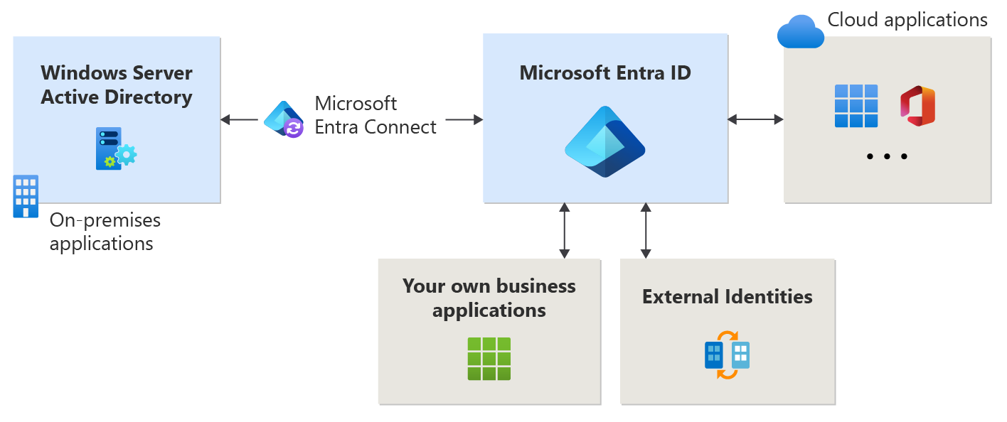
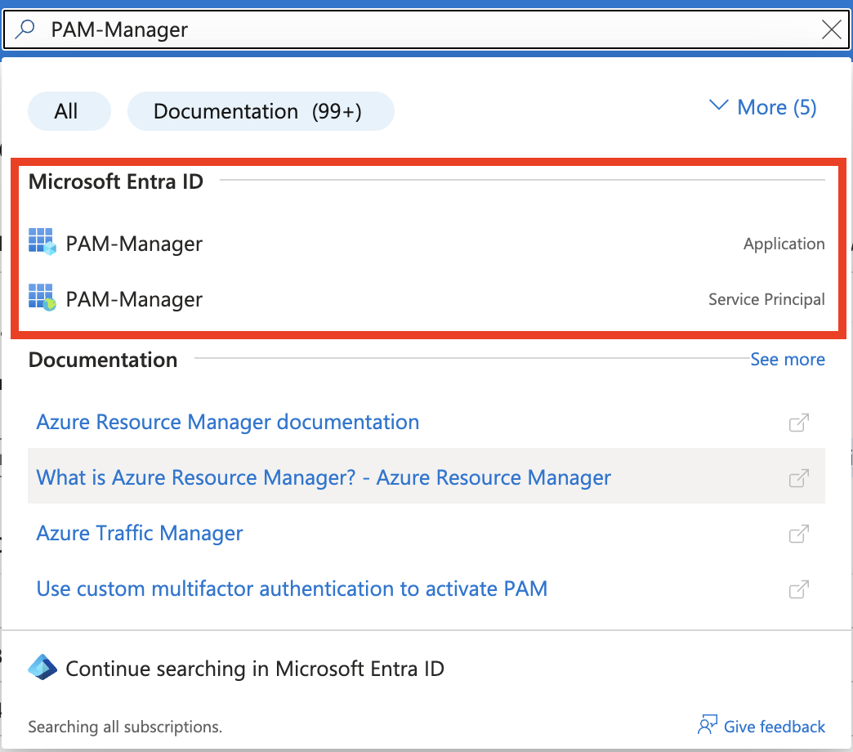
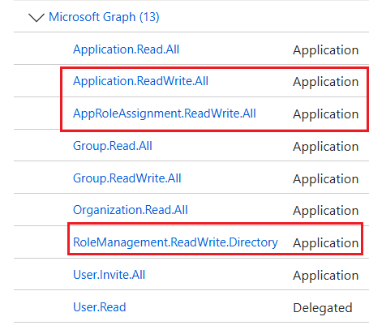
Existing Landscape
Notes:
visualize what a modern hybrid identity
Entra is the identity provider for custom business & cloud apps
authenticating, syncing, authorizing, and executing workflows nonstop
blind spot. And that’s what this talk is all about

Slide 12
Existing Landscape
Sep 16, 2019
Azure AD privilege escalation - Taking over default application permissions as Application Admin - Dirk-jan Mollema (Outsider Security) [1]
Jan 26, 2021
Abusing Azure Application Credentials to Attack Supply Chains – Secureworks Research Team [2]
Oct 12, 2021
Azure Privilege Escalation via Service Principal Abuse - Andy Robbins (SpecterOps)[3]
Dec 01, 2021
Azure Privilege Escalation via Azure API Permissions Abuse - Andy Robbins (SpecterOps)[4]
April 21, 2023
Azure Privilege Escalation Via Service Principal - Karan Patel (Redfox Security)[5]
July 31, 2024
Persisting on Entra ID applications and User Managed Identities with Federated Credentials - Dirk-jan Mollema (Outsider Security)[6]
Nov 06, 2024
(In)tuned to Takeovers: Abusing Intune Permissions in Entra ID – Mandiant Research Team [7]
* All hyperlinks are included in the References section.

Slide 13

TO OLYMPUS AND BEYOND The CLOUDS

Slide 14
To Olympus and Beyond the Clouds
What You Will Learn:
Reveals how high-trust, integrated enterprise apps can become privileged attack platforms
Expose The Risks of Trusted Applications
Red teamers will gain new post-exploitation techniques
Based in Real-World Scenarios
Shifts focus from user accounts to non-human identities (SPs)

Slide 15
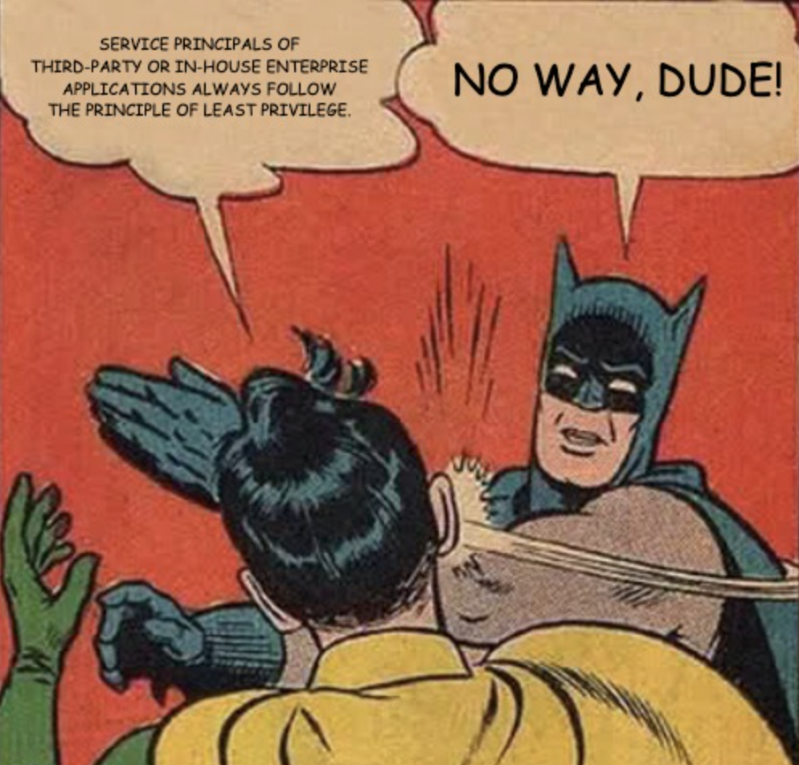
To Olympus and Beyond the Clouds

Slide 16
To Olympus and Beyond the Clouds
“The cloud is strong with this one — but it’s serving the Dark Side.”
Developed 4 scenarios based on real world experience:
From App Owner to Azure Full Access
Leveraging Service Principal to Access O365 Mailbox
Code Execution via Intune Win32 LOB Apps
Abusing Azure DevOps Admin to compromise Privileged Service Principal

Slide 17

FROM APP Owner TO AZURE FULL ACCESS

Slide 18
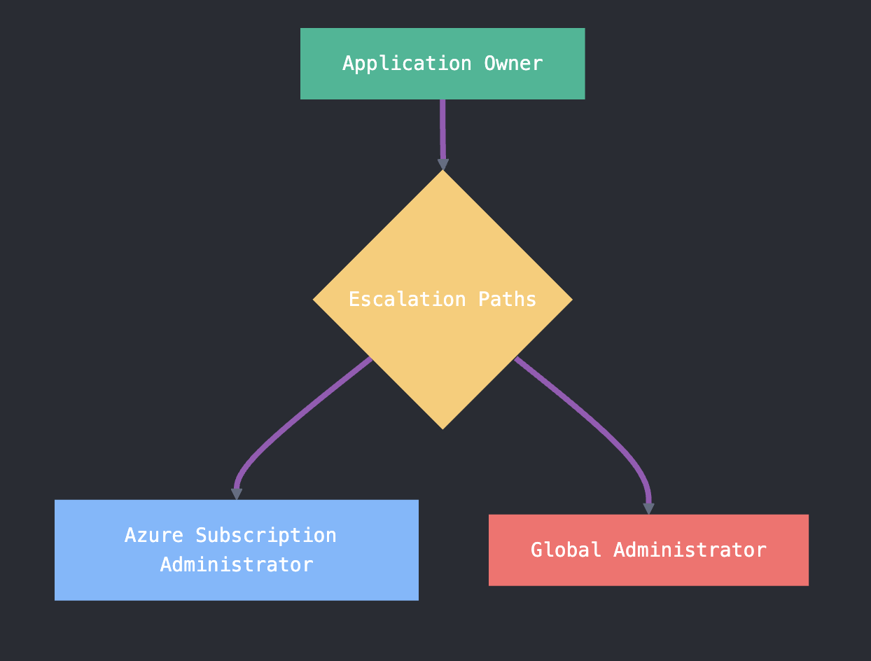
FROM APP Owner TO AZURE FULL ACCESS
Notes:
What is New? Multiple Steps
Based On real world experience

Slide 19
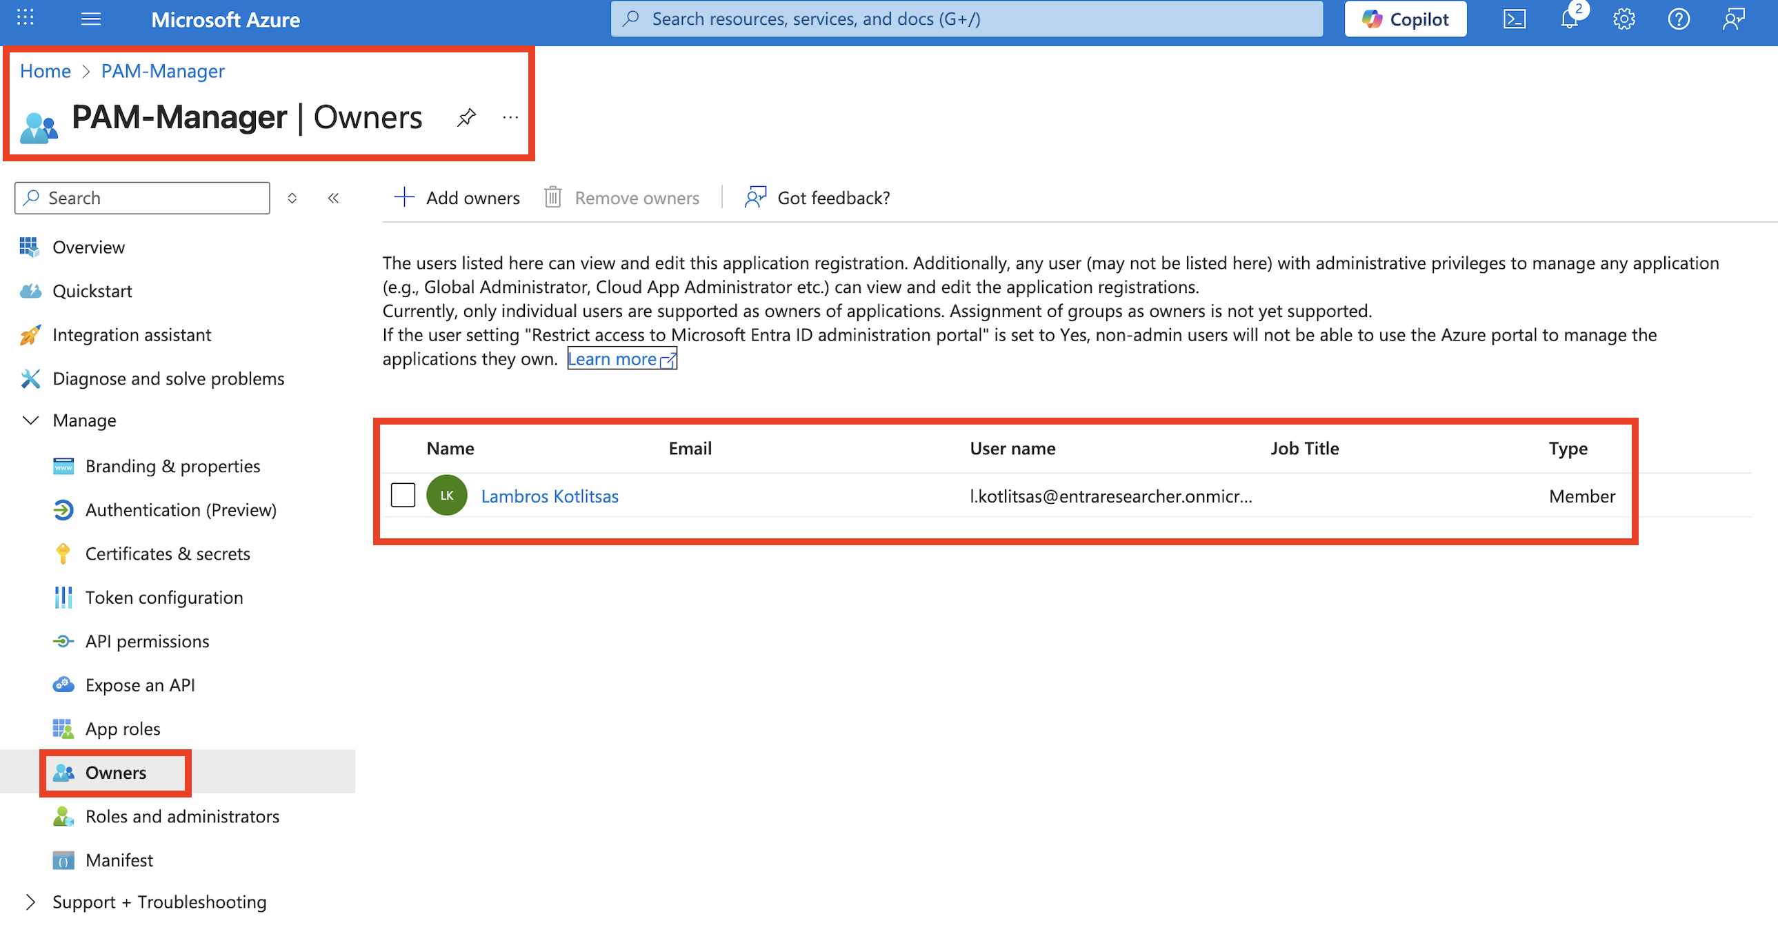
FROM APP Owner TO AZURE FULL ACCESS

Slide 20
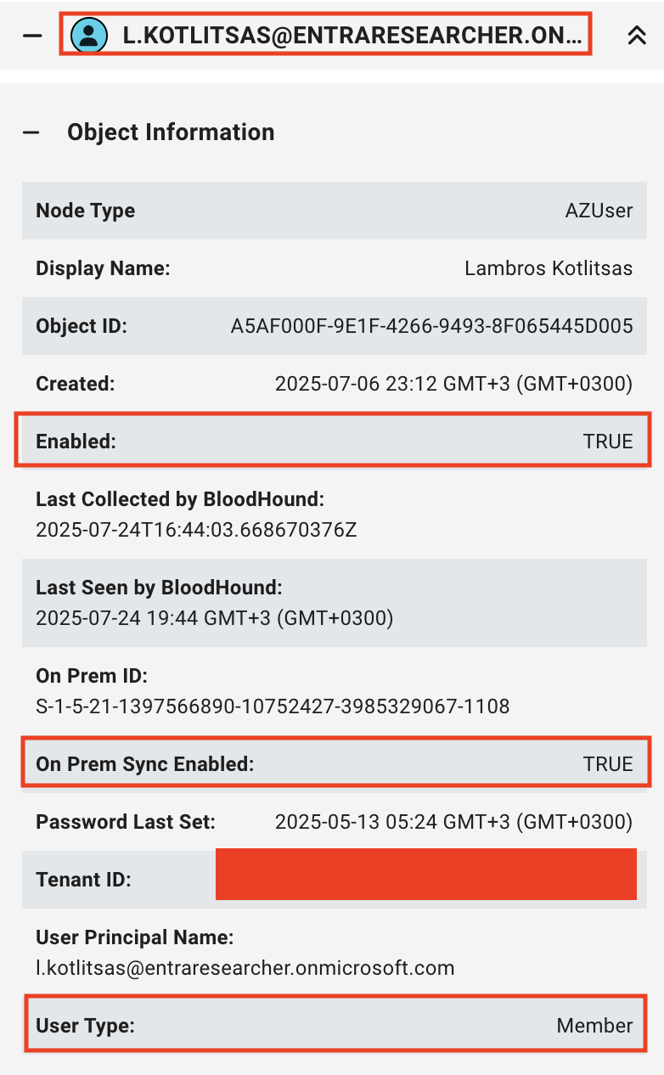
FROM APP Owner TO AZURE FULL ACCESS

Slide 21
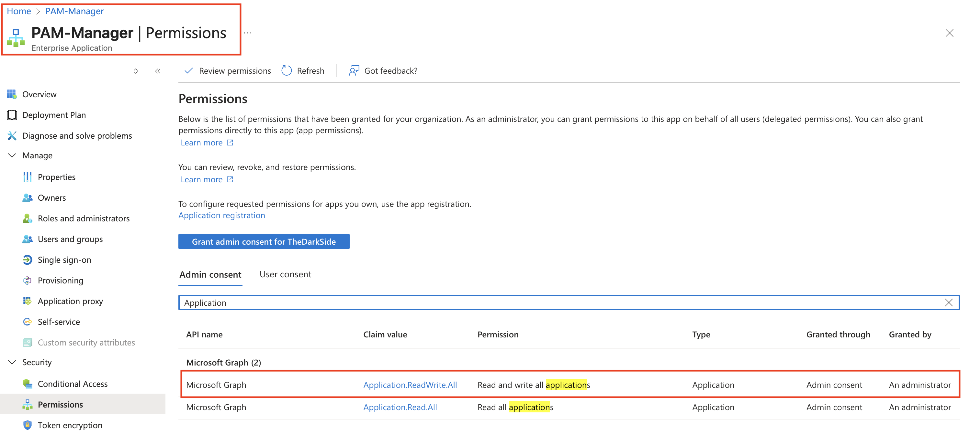
FROM APP Owner TO AZURE FULL ACCESS

Slide 22
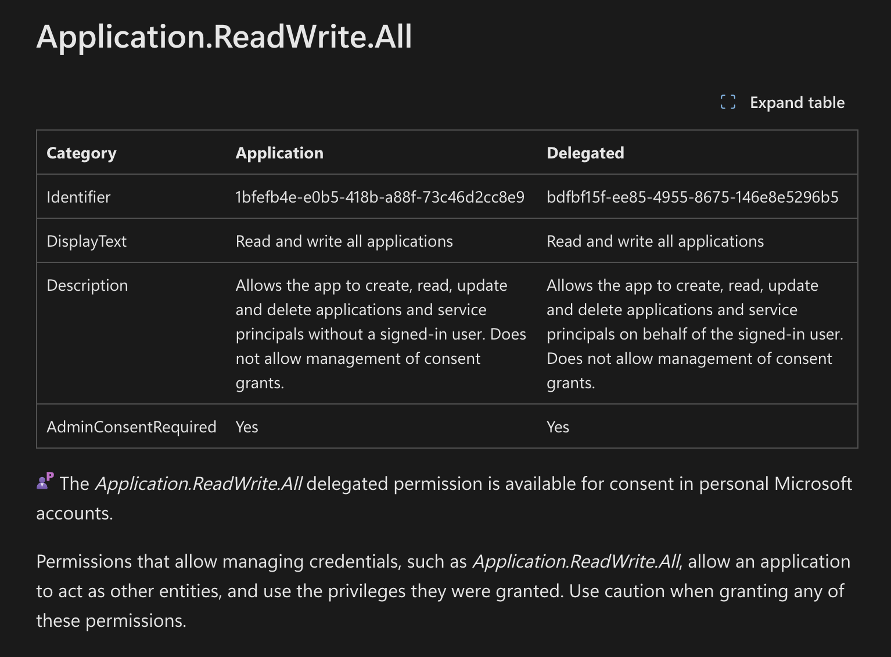

FROM APP Owner TO AZURE FULL ACCESS

Slide 23
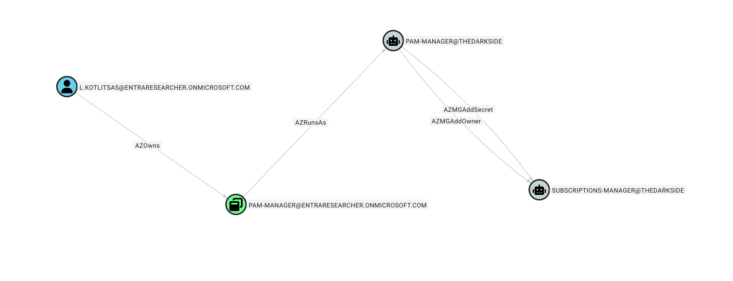

FROM APP Owner TO AZURE FULL ACCESS

Slide 24
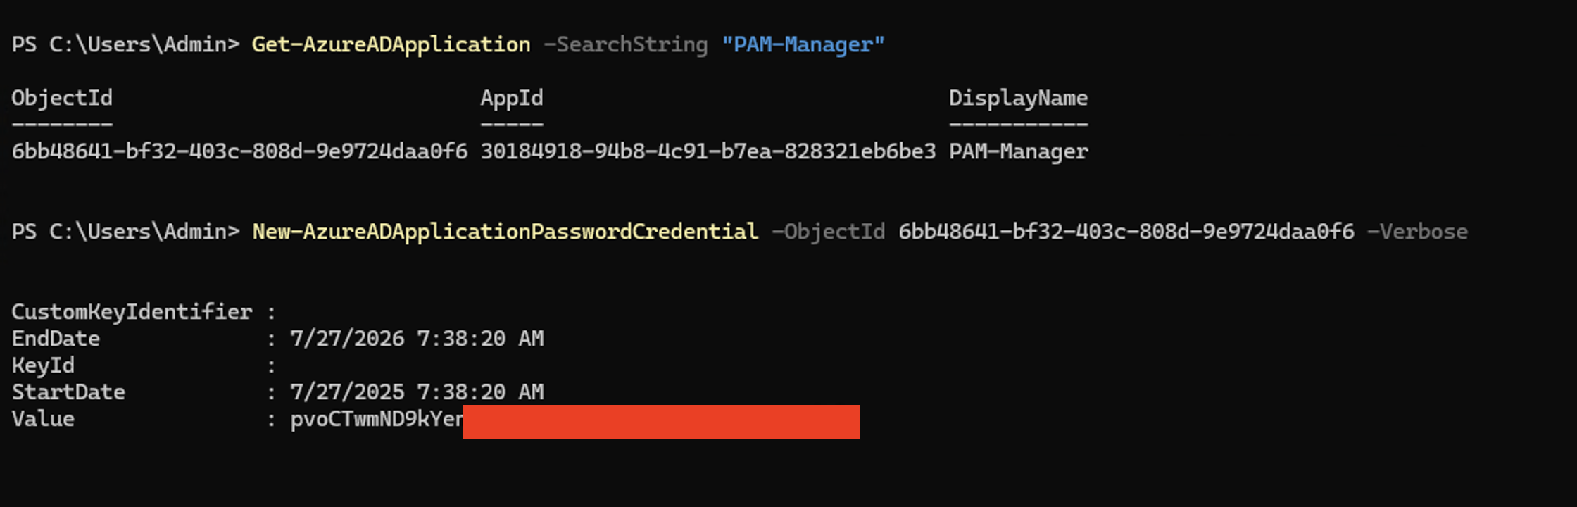
FROM APP Owner TO AZURE FULL ACCESS

Slide 25
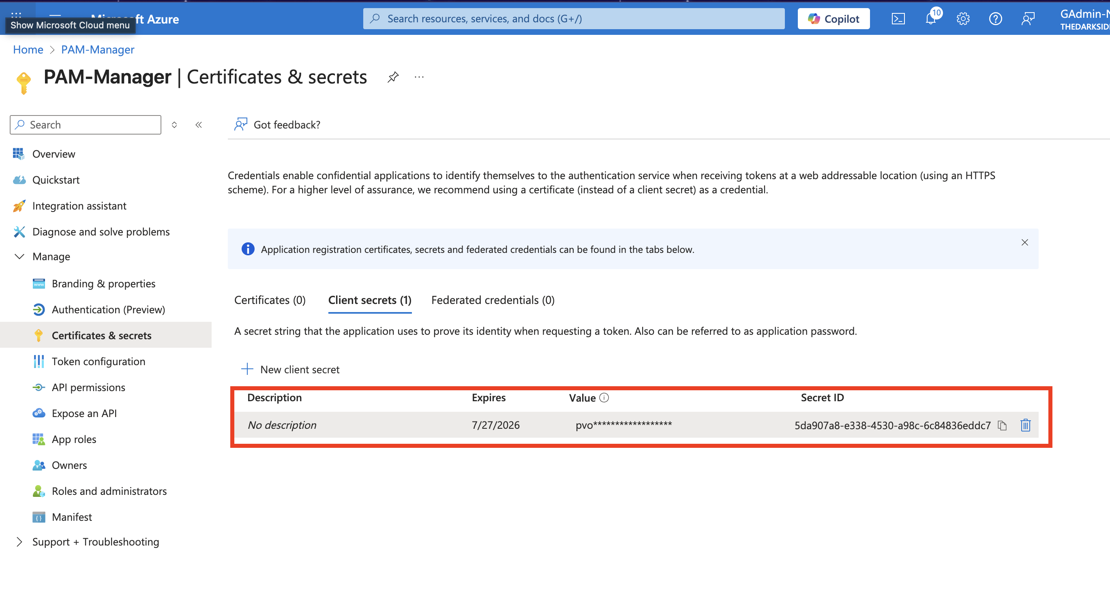
FROM APP Owner TO AZURE FULL ACCESS

Slide 26
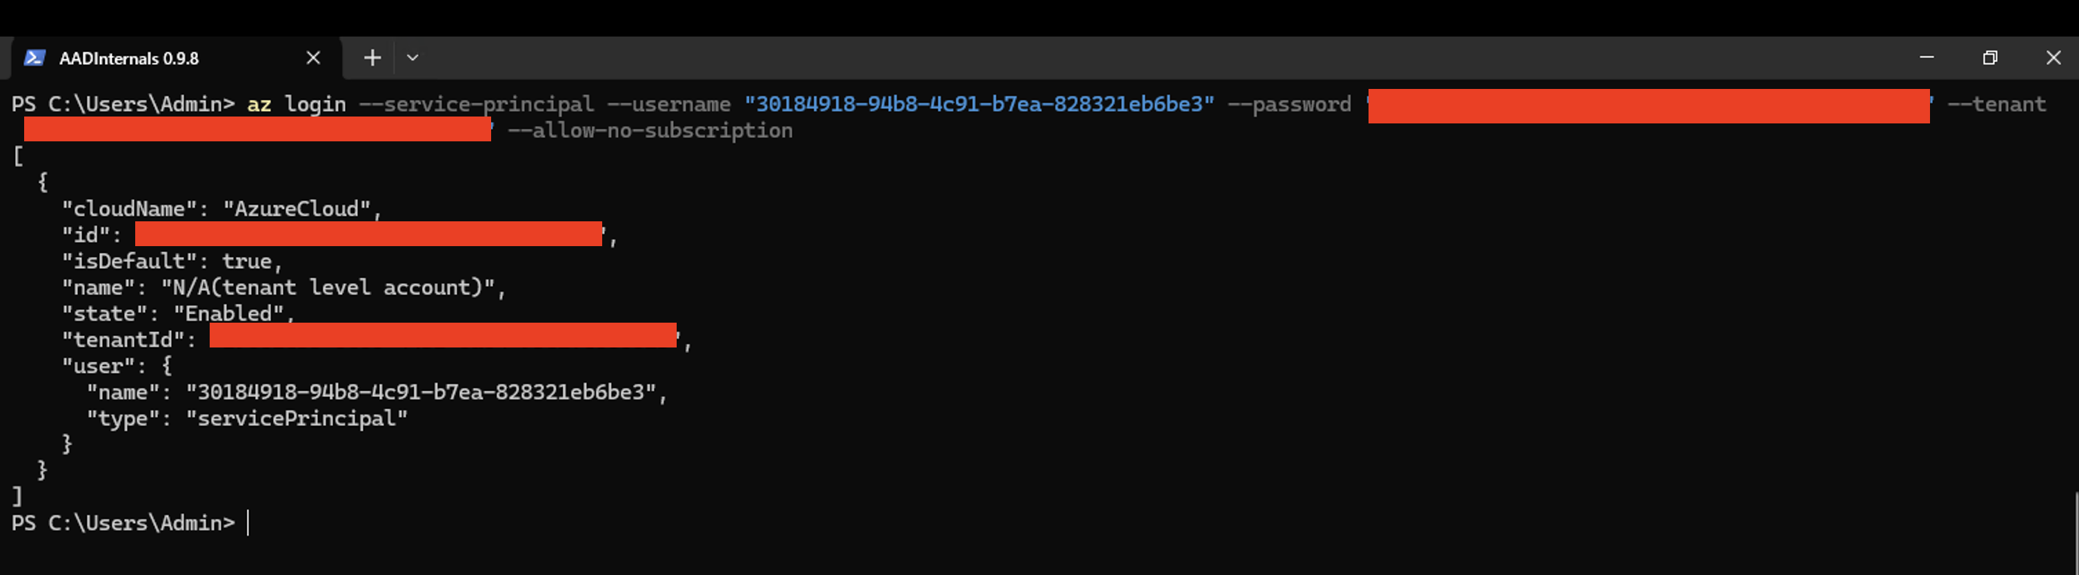
FROM APP Owner TO AZURE FULL ACCESS

Slide 27
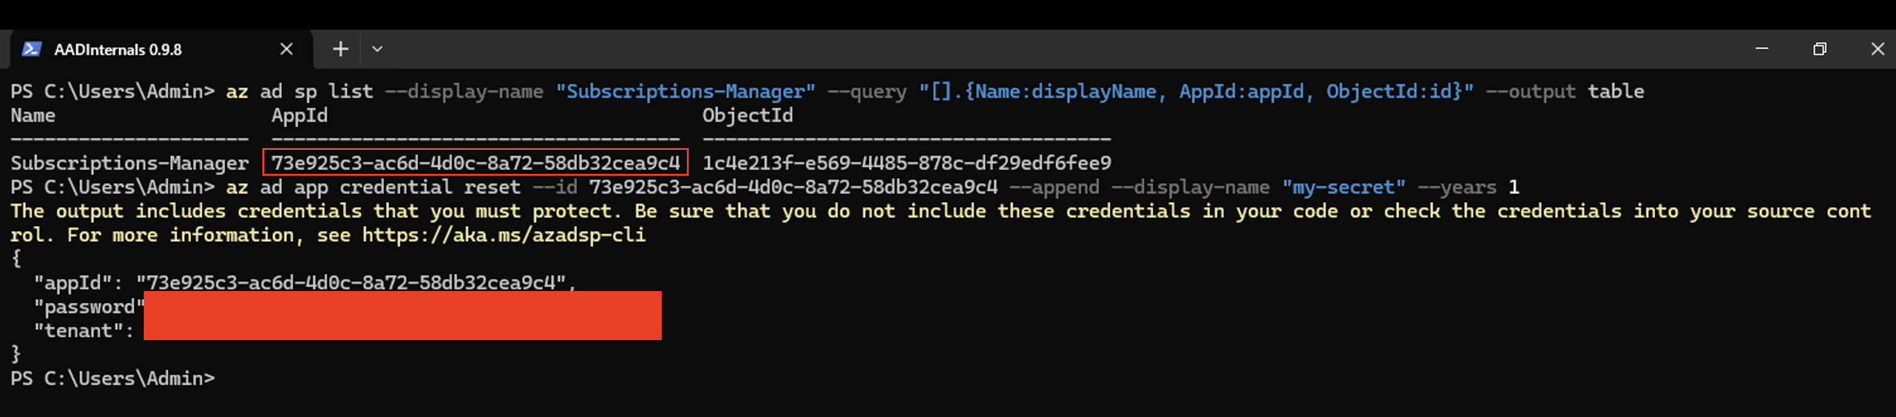
FROM APP Owner TO AZURE FULL ACCESS

Slide 28
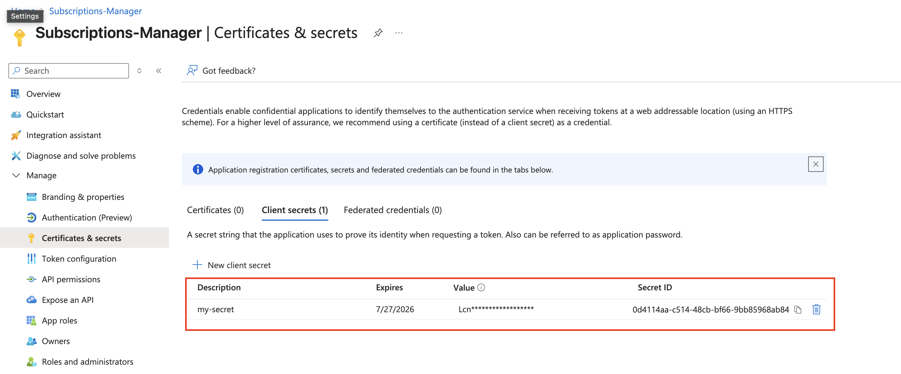
FROM APP Owner TO AZURE FULL ACCESS

Slide 29
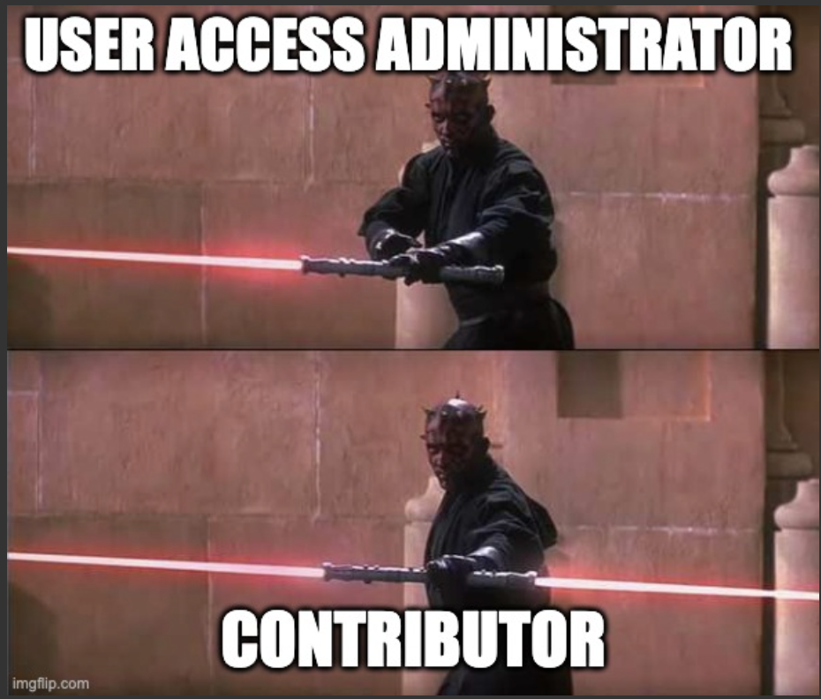
FROM APP Owner TO AZURE FULL ACCESS
This is how it ends in 9 out of 10 cases (So far)
* Based on our internal statistics for 2025

Slide 30
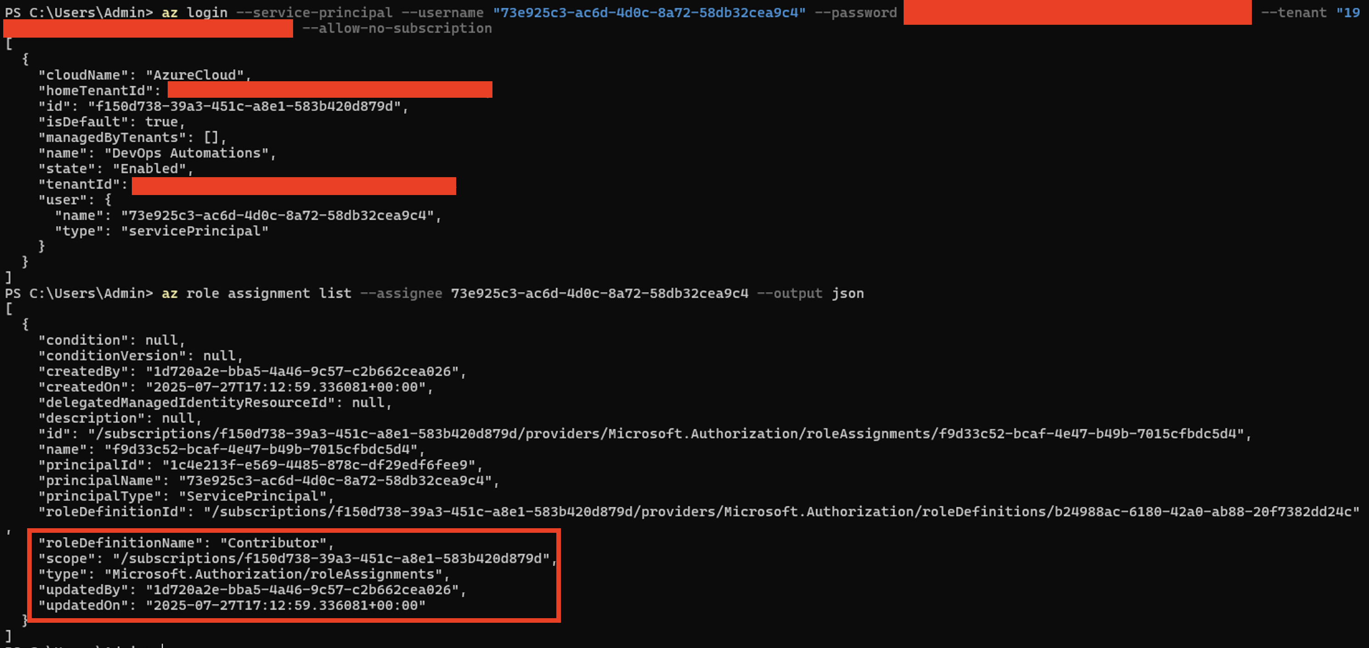
FROM APP Owner TO AZURE FULL ACCESS

Slide 31
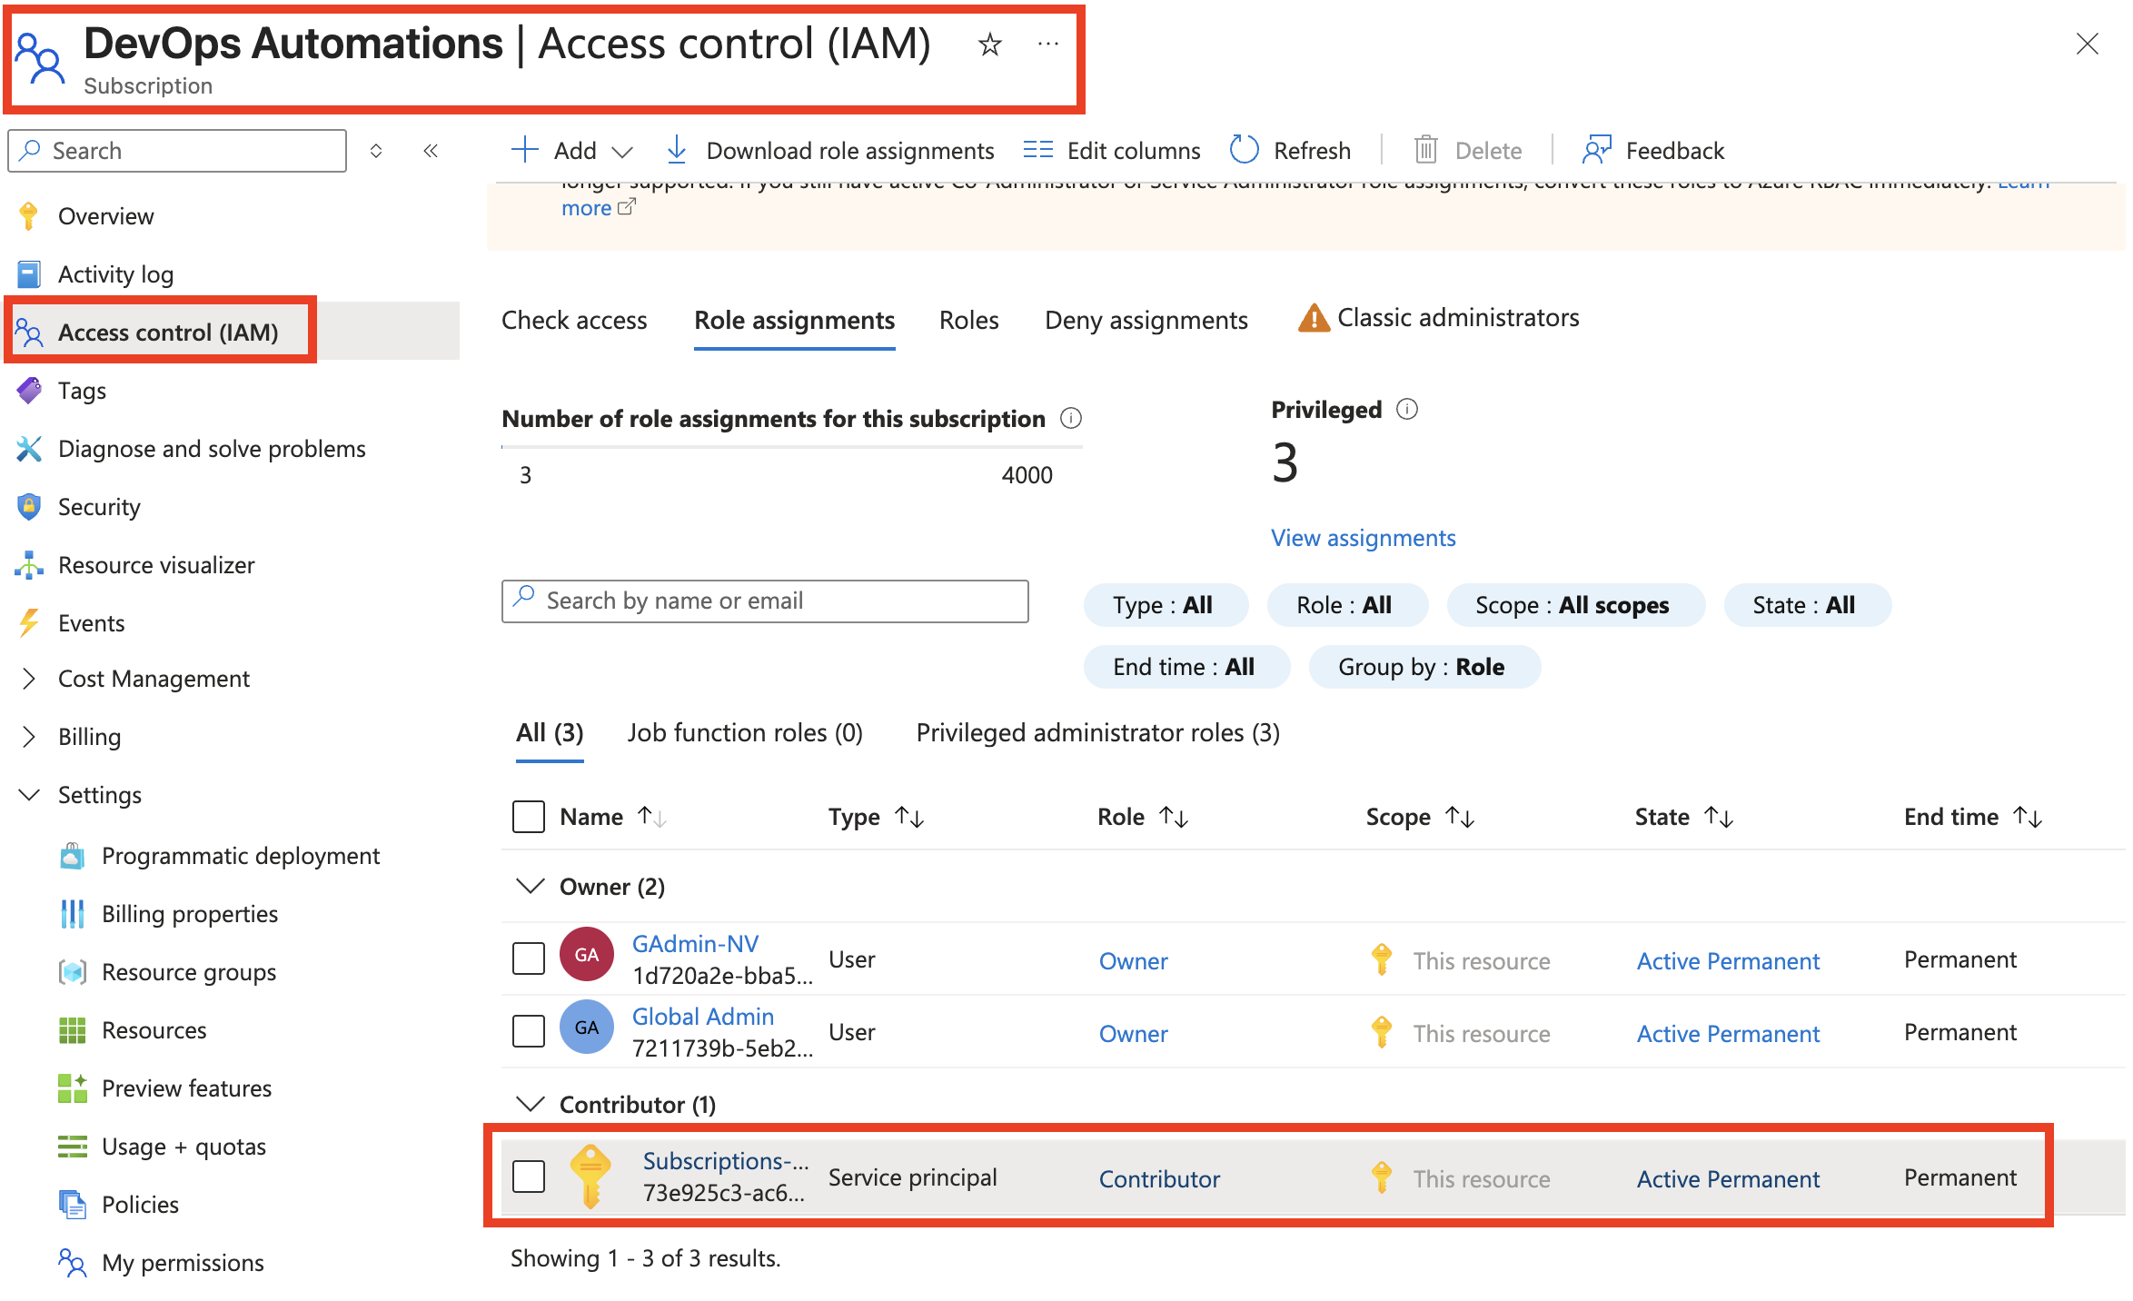
FROM APP Owner TO AZURE FULL ACCESS

Slide 32
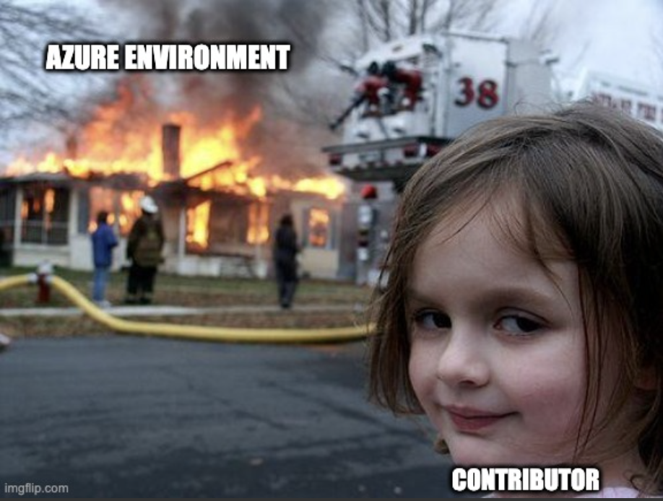
FROM APP Owner TO AZURE FULL ACCESS

Slide 33
FROM APP Owner TO AZURE FULL ACCESS
However, Service Principal misconfigurations affect not only Azure Resources, but also Entra ID.

Slide 34
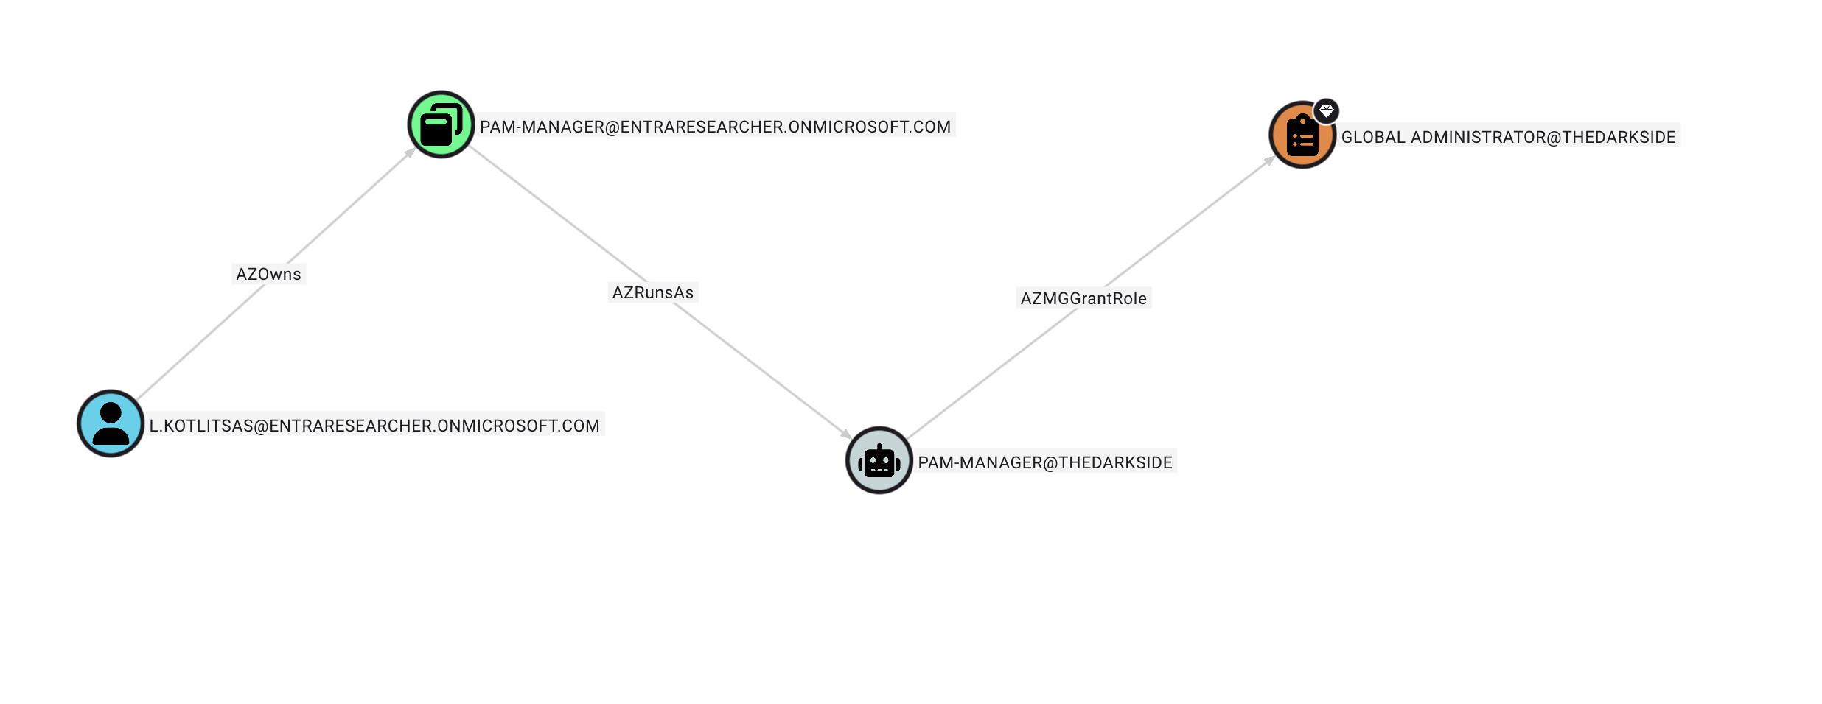
FROM APP Owner TO AZURE FULL ACCESS
Notes:
RoleManagement.ReadWrite.Directory

Slide 35
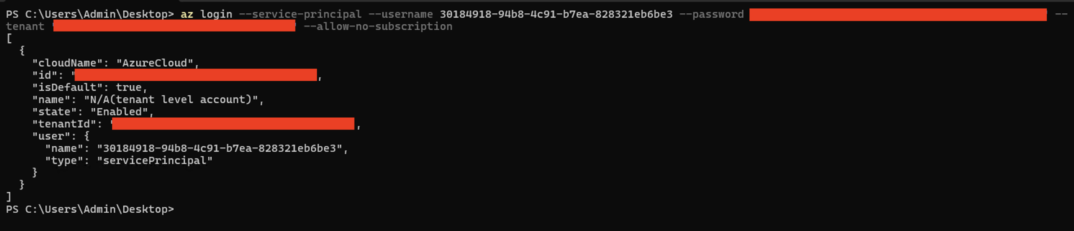
FROM APP Owner TO AZURE FULL ACCESS
Let’s skip the previous steps and assume we already have access
to the PAM-Manager service principal…

Slide 36
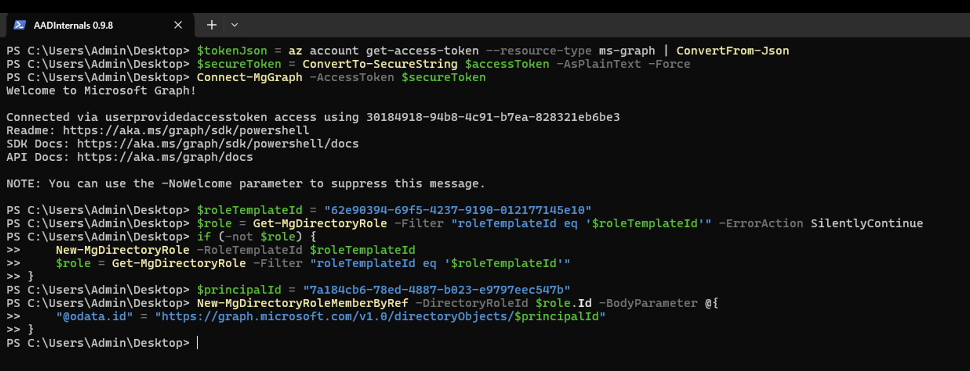
FROM APP Owner TO AZURE FULL ACCESS

Slide 37
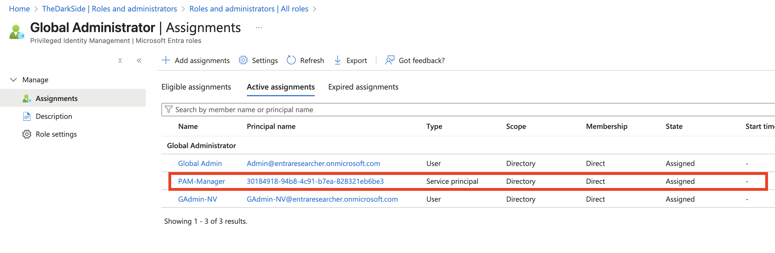
FROM APP Owner TO AZURE FULL ACCESS

Slide 38

Leveraging SERVICE PRINCIPAL TO Access o365 mailbox
Notes:
- The main scope of this scenario is to show how in a Red Teaming engangement you can use the service principals to blendin and read emails of other users.

Slide 39
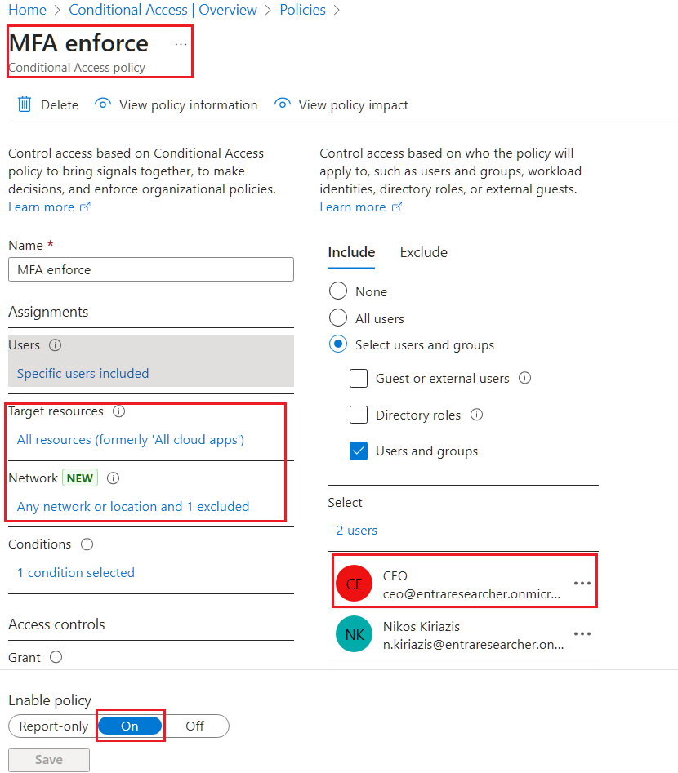
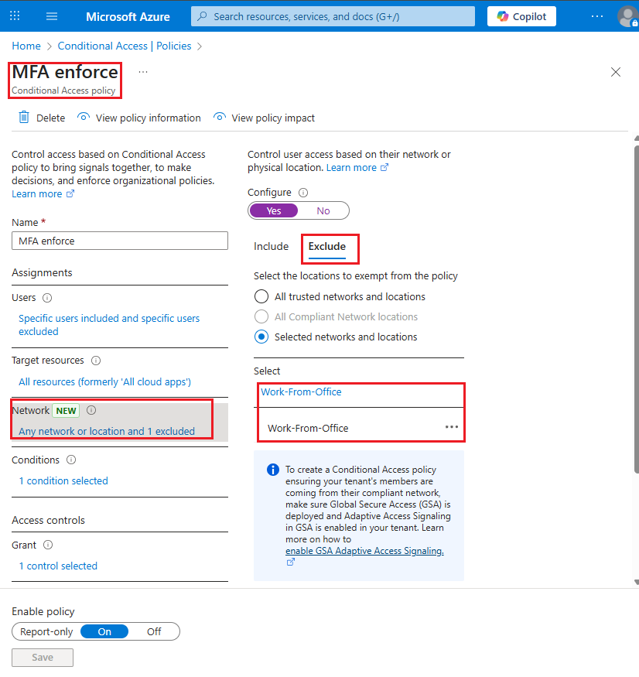
Leveraging SERVICE PRINCIPAL TO Access o365 mailbox

Slide 40
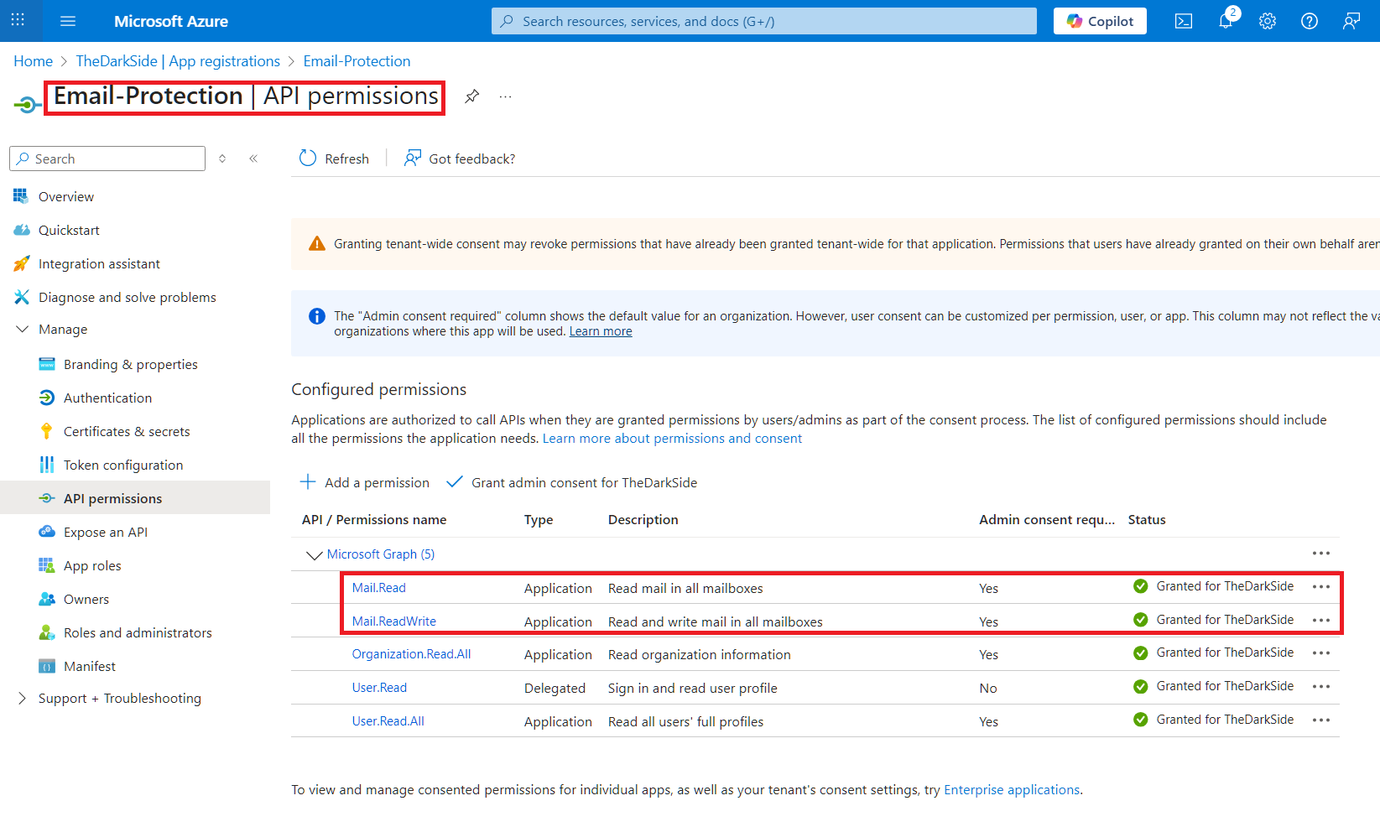
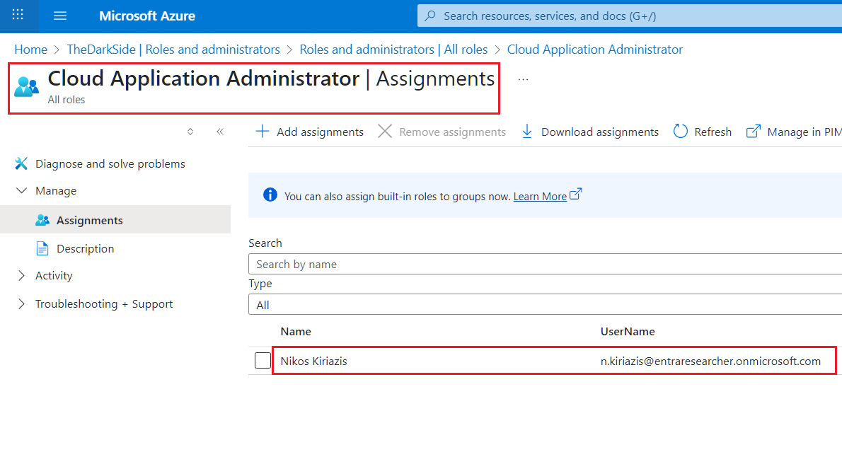
Leveraging SERVICE PRINCIPAL TO Access o365 mailbox

Slide 41
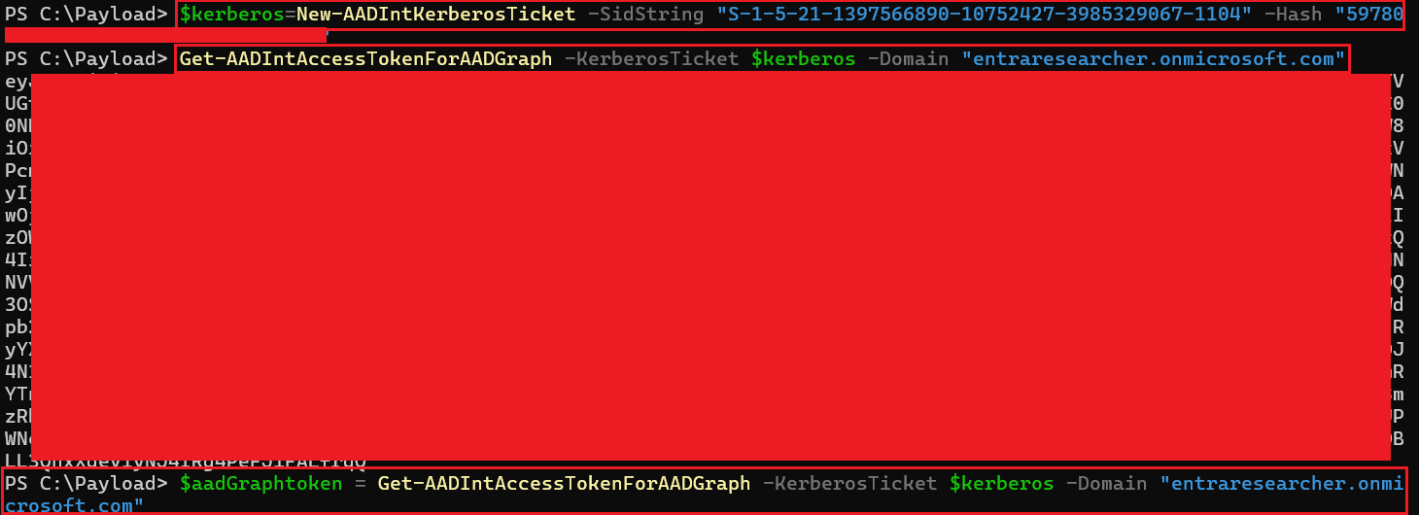
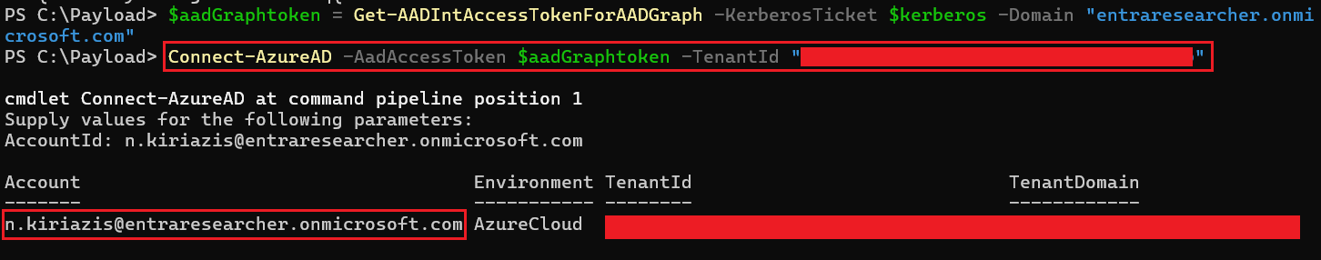
Leveraging SERVICE PRINCIPAL TO Access o365 mailbox

Slide 42
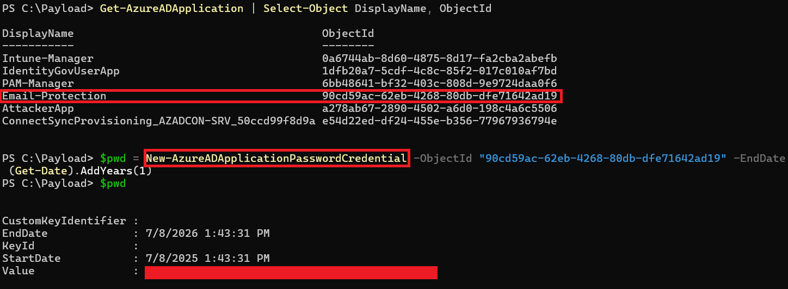
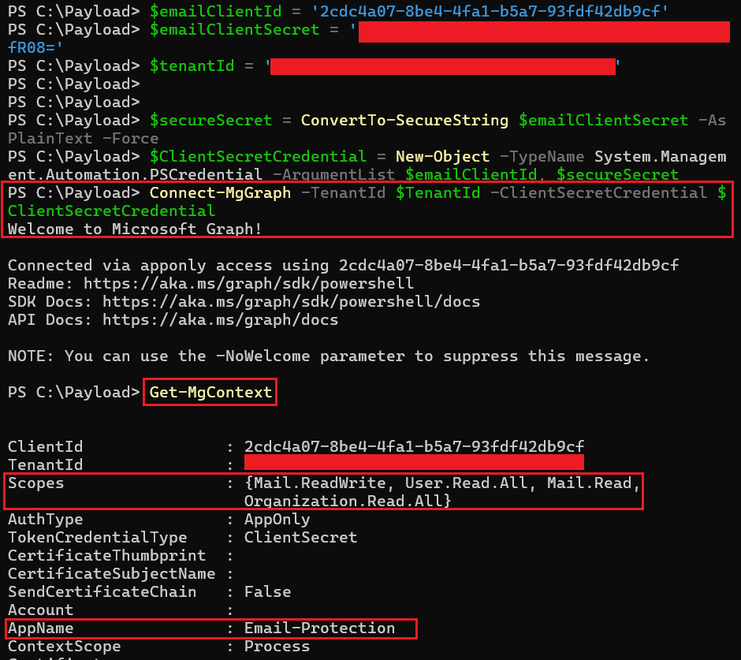
Leveraging SERVICE PRINCIPAL TO Access o365 mailbox

Slide 43
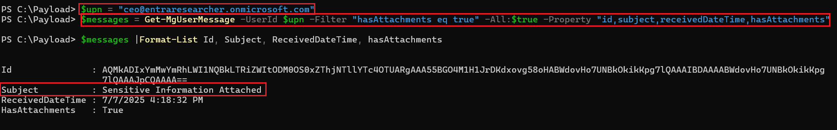
Leveraging SERVICE PRINCIPAL TO Access o365 mailbox

Slide 44
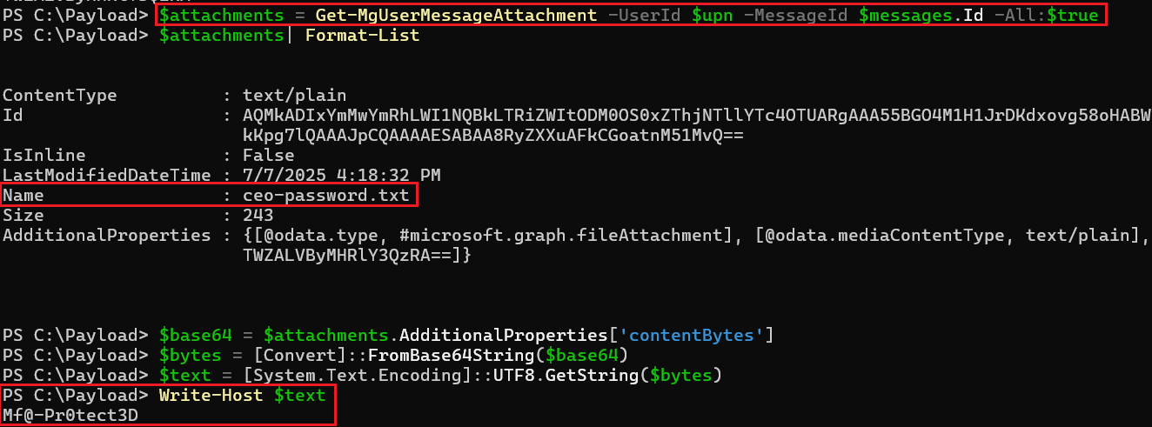
Leveraging SERVICE PRINCIPAL TO Access o365 mailbox
Notes:
The value of this attack?
Blend In by abusing legit Service Principals

Slide 45

CODE EXECUTION via INTUNE LOB APPs

Slide 46
CODE EXECUTION via INTUNE LOB APPs
Step 1: Abuse Intune Application related permissions (DeviceManagementApps)
1
Step 2: Create LOB apps for Intune.
2
Step 3: Deploy malicious Windows Application.
3
Step 4: Obtain System Privileges.

Slide 47
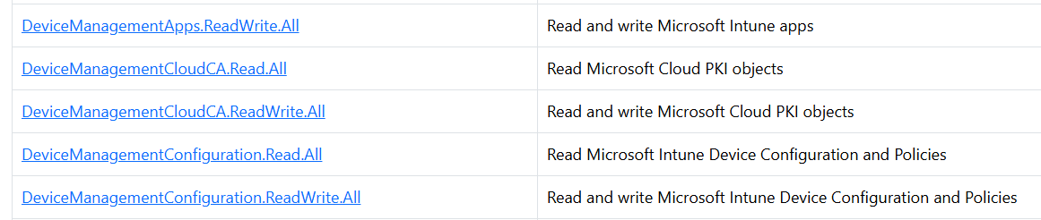
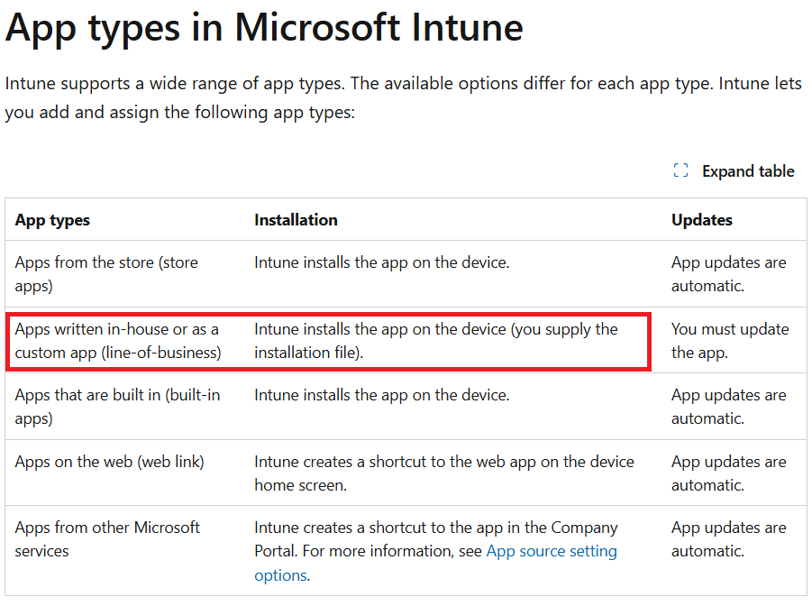
CODE EXECUTION via INTUNE LOB APPs
But What’s New?

Slide 48
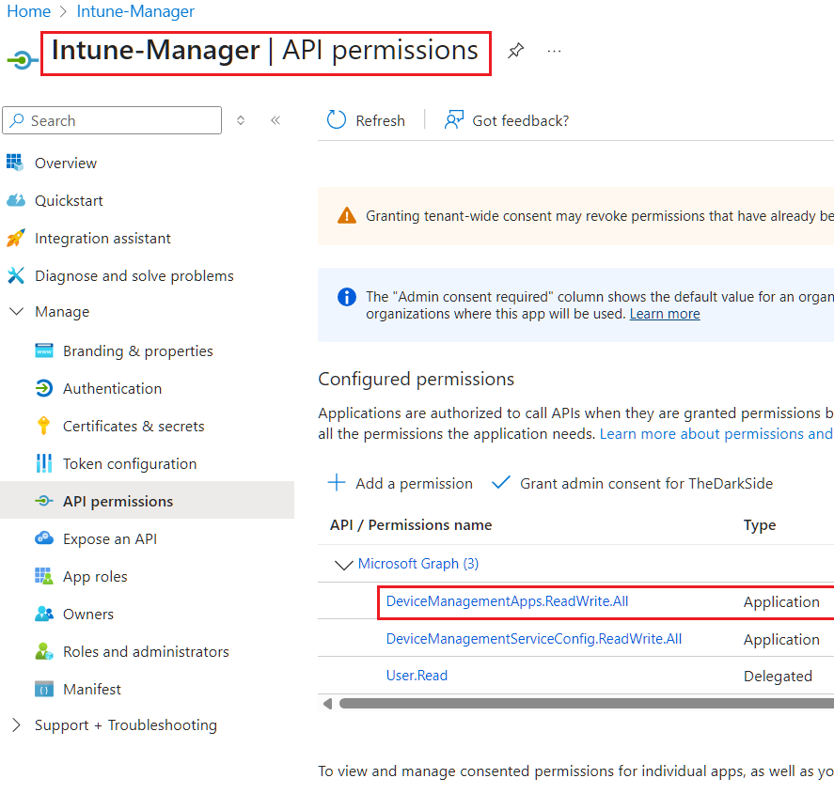
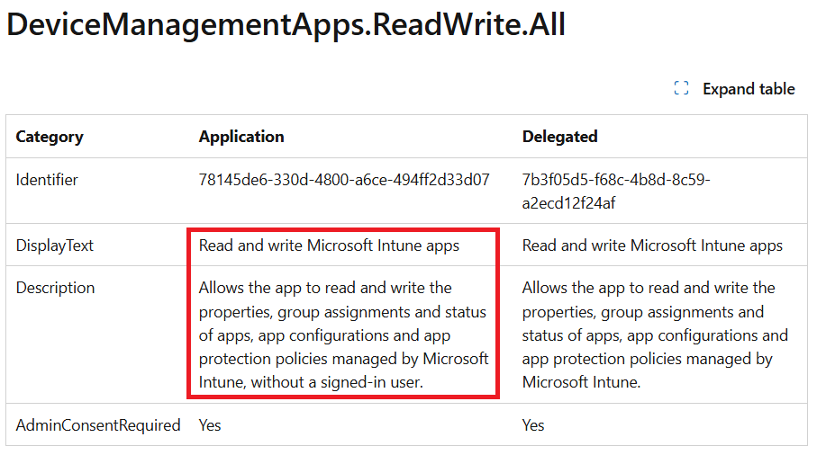
CODE EXECUTION via INTUNE LOB APPs

Slide 49
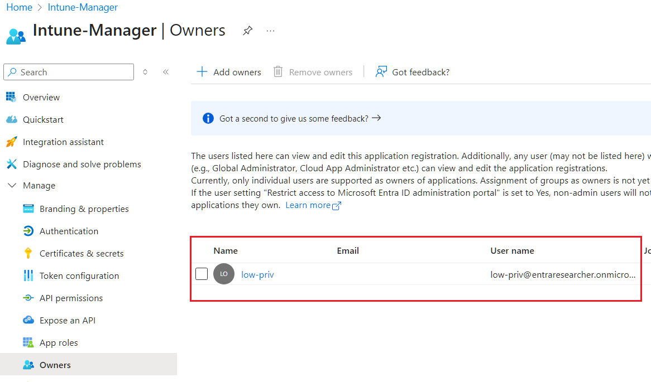
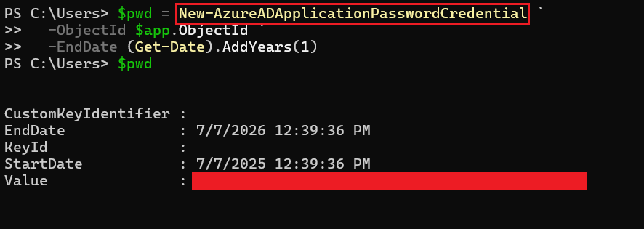
CODE EXECUTION via INTUNE LOB APPs

Slide 50
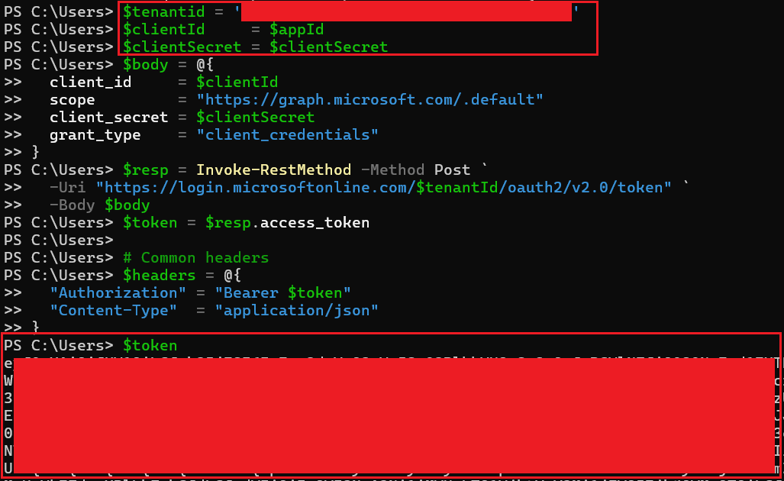
CODE EXECUTION via INTUNE LOB APPs

Slide 51
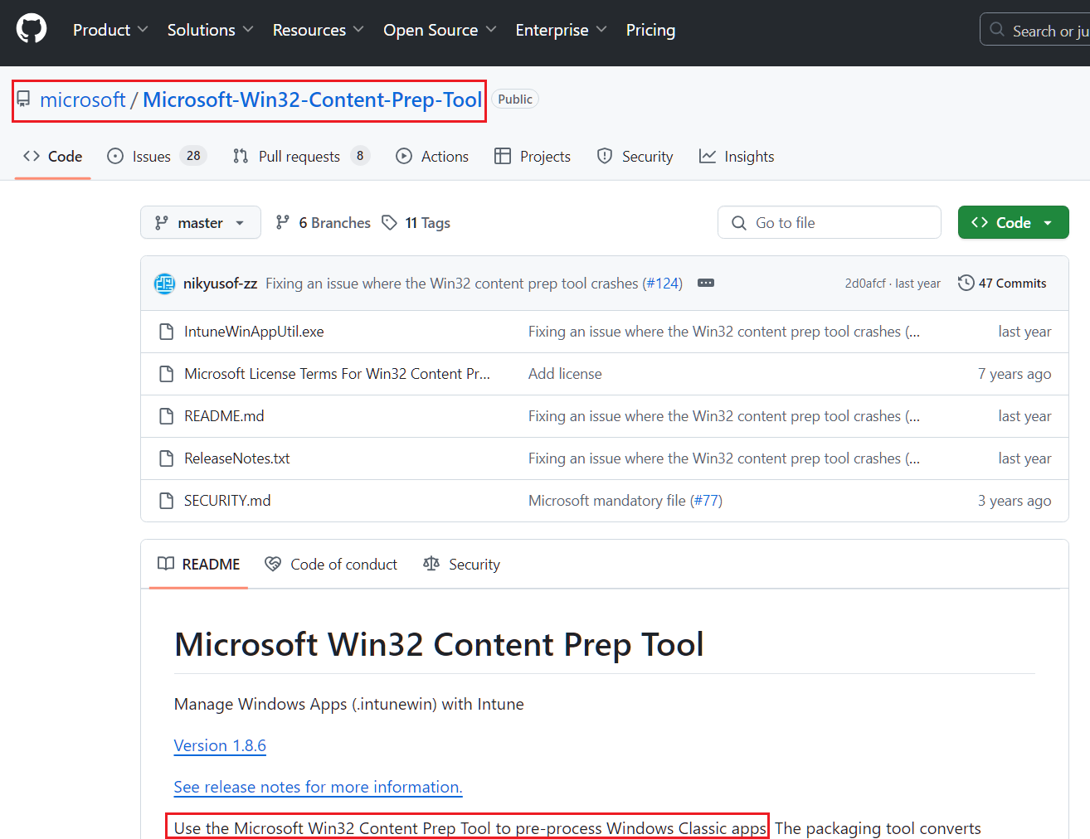
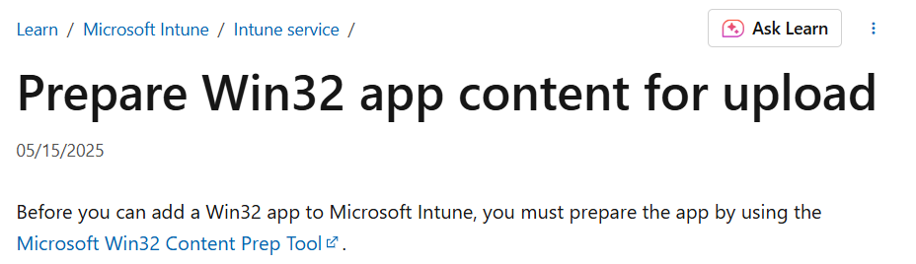
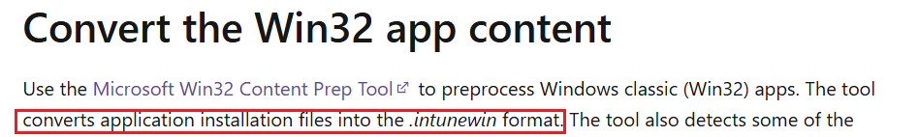
CODE EXECUTION via INTUNE LOB APPs
Wait, what files can we upload?

Slide 52
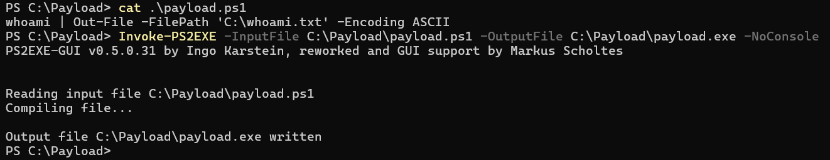
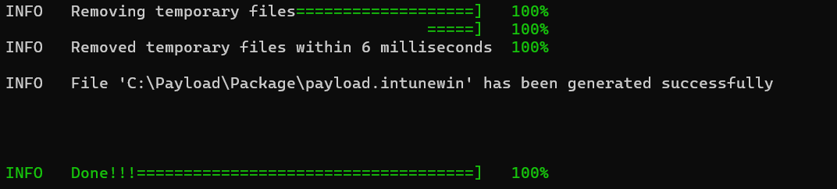
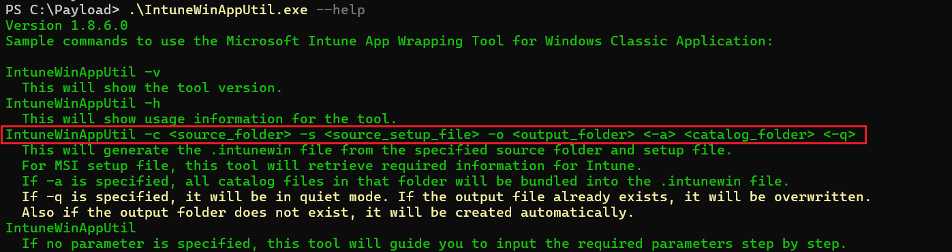
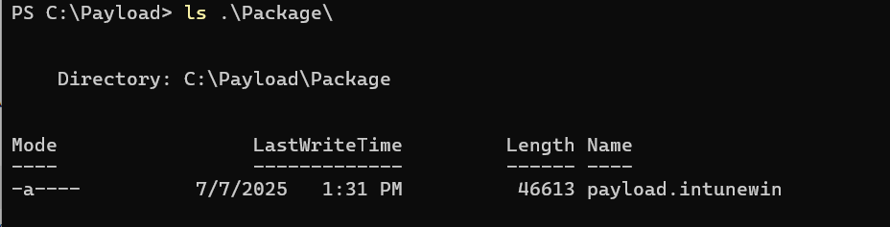
CODE EXECUTION via INTUNE LOB APPs

Slide 53
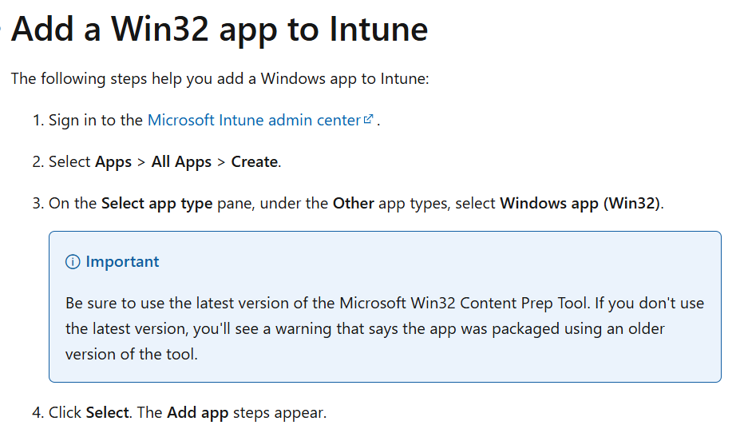

CODE EXECUTION via INTUNE LOB APPs
Off to Payload Upload!
Well, not so fast Dude!
What if…
No Intune Admin Center access?

Slide 54
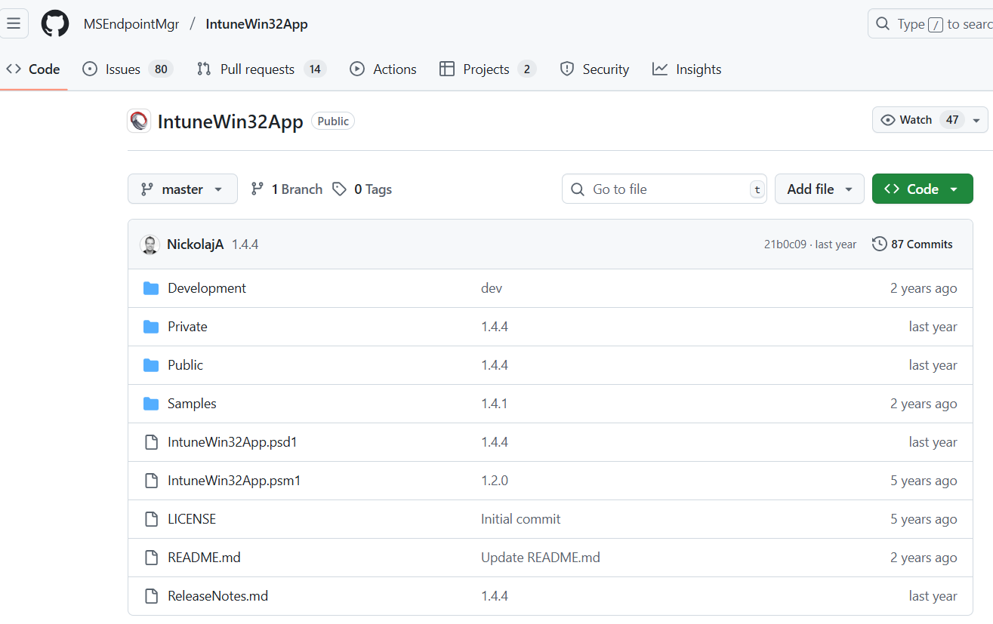
CODE EXECUTION via INTUNE LOB APPs
GitHub to the rescue:
https://github.com/MSEndpointMgr/IntuneWin32App

Slide 55
CODE EXECUTION via INTUNE LOB APPs
GitHub to the rescue:
https://github.com/MSEndpointMgr/IntuneWin32App

Slide 56

CODE EXECUTION via INTUNE LOB APPs

Slide 57

CODE EXECUTION via INTUNE LOB APPs

Slide 58

CODE EXECUTION via INTUNE LOB APPs

Slide 59

CODE EXECUTION via INTUNE LOB APPs

Slide 60

CODE EXECUTION via INTUNE LOB APPs

Slide 61


CODE EXECUTION via INTUNE LOB APPs

Slide 62

CODE EXECUTION via INTUNE LOB APPs

Slide 63

CODE EXECUTION via INTUNE LOB APPs
W00t! W00t! Baby!☺

Slide 64

Abusing Azure DevOps Admin to compromise Privileged Service Principal

Slide 65
Abusing Azure DevOps Admin to compromise Privileged Service Principal
BUT You need to be PRIVILEGED to Compromise Service Principals
Cloud Application Administrator is not ALWAYS the Only Way
Owner is not ALWAYS the Only Way
Each Organization is a UNIQUE Environment
DevOps is Becoming a Part of a LOT Organizations
So, What can We Do with Azure DevOps?

Slide 66



Abusing Azure DevOps Admin to compromise Privileged Service Principal
Azure DevOps Administrator – NOT PRIVILEGES Or Is IT?!

Slide 67


Abusing Azure DevOps Admin to compromise Privileged Service Principal

Slide 68


Abusing Azure DevOps Admin to compromise Privileged Service Principal

Slide 69



Abusing Azure DevOps Admin to compromise Privileged Service Principal
Where Do We Find Orphaned Orgs?
AZ DEVOPS CLI – Well Not Really?!

Slide 70



Abusing Azure DevOps Admin to compromise Privileged Service Principal

Slide 71


Abusing Azure DevOps Admin to compromise Privileged Service Principal

Slide 72


Abusing Azure DevOps Admin to compromise Privileged Service Principal

Slide 73



Abusing Azure DevOps Admin to compromise Privileged Service Principal

Slide 74


Abusing Azure DevOps Admin to compromise Privileged Service Principal

Slide 75

Abusing Azure DevOps Admin to compromise Privileged Service Principal

Slide 76

Abusing Azure DevOps Admin to compromise Privileged Service Principal
But Where is The Service Principal?

Slide 77


Abusing Azure DevOps Admin to compromise Privileged Service Principal

Slide 78



Abusing Azure DevOps Admin to compromise Privileged Service Principal

Slide 79


Abusing Azure DevOps Admin to compromise Privileged Service Principal

Slide 80

Abusing Azure DevOps Admin to compromise Privileged Service Principal

Slide 81

Community Toys for Girlz && Boyz

Slide 82
Community Toys for Girlz && Boyz
App-Hunter - A Go-To PowerShell Tool to:
Hunting Overprivileged Service Principals
Surfaces Entra ID and Subscription roles as well as app permissions that create unnecessary or unsafe blast radius
Flags dangerous permissions
Designed for red teamers, cloud security researchers, and defenders to identify privilege escalation risks

Slide 83

Community Toys for Girlz && Boyz

Slide 84

DETECTIONS & remediation

Slide 85

DETECTIONS & remediation

Slide 86

DETECTIONS & remediation

Slide 87

DETECTIONS & remediation

Slide 88

DETECTIONS & remediation

Slide 89
DETECTIONS & remediation
Enterprise applications Must be Configured According to the Principle of Least Privilege
Regularly REVIEW Enterprise Application Permissions
Custom Application Owners Should be Monitored as High-Privileged Users
Configure DevOps Security for Microsoft Defender For Cloud
Cloud Application Administrators SHOULD BE Treated as Highly-Privileged Role
Consider Conditional Access for Workload Identities
Conditional Access Policy (CAP) should Require Multifactor Authentication Regardless of the Location

Slide 90

Q&A

Slide 91
References
[1] https://dirkjanm.io/azure-ad-privilege-escalation-application-admin/
[2] https://www.secureworks.com/research/abusing-azure-application-credentials-to-attack-supply-chains
[3] https://posts.specterops.io/azure-privilege-escalation-via-service-principal-abuse-210ae2be2a5
[4] https://posts.specterops.io/azure-privilege-escalation-via-azure-api-permissions-abuse-74aee1006f48
[5] https://redfoxsec.com/blog/azure-privilege-escalation-via-service-principal/
[6] https://dirkjanm.io/persisting-with-federated-credentials-entra-apps-managed-identities/
[7] https://cloud.google.com/blog/topics/threat-intelligence/abusing-intune-permissions-entra-id-environments

